Slide 1
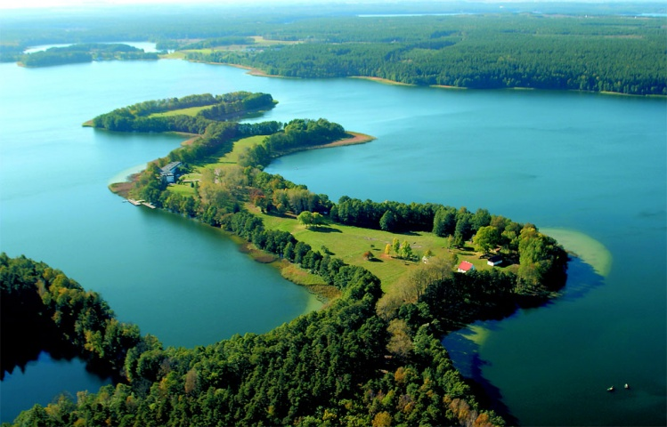
Poland
I am going to tell you about Poland, my homeland. Not everyone knows that Poland is a beautiful country, with long history and great traditions. We have here rivers, lakes, forests and beaches with Baltic Sea. Our capital city - Warsaw - is big and beautiful. Masuria was a candidate for one of the most beautiful places in Europe. I could tell a lot more…

Slide 2
Flag of Poland Coat of arms of Poland

Slide 3
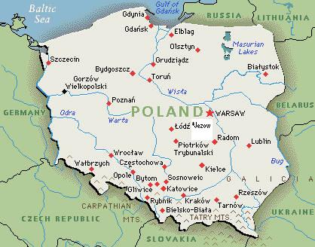
Location
Poland is a country in Central Europe bordered by Germany to the west; the Czech Republic and Slovakia to the south; Ukraine and Belarus to the east; and the Baltic Sea, Kaliningrad Oblast (a Russian exclave) and Lithuania to the north. The total area of Poland is 312,679 square kilometers making it the 71st largest country in the world and the 9th largest in Europe .

Slide 4
Politics
Poland is a democracy, with a president as a head of state, whose current constitution dates from 1997. Poland is a peaceful country. The government structure centers on the Council of Ministers, led by a prime minister. The president appoints the cabinet according to the proposals of the prime minister, typically from the majority coalition in the Sejm. The president is elected by popular vote every five years. The president is Bronisław Komorowski.
The current prime minister, Ewa Kopacz, was appointed in 2014 after the resignation of Donald Tusk who was elected President of the European Council.
Polish voters elect a bicameral parliament consisting of a 460-member lower house (Sejm) and a 100-member Senate. The Sejm is elected under proportional representation according to the d'Hondt method, a method similar to that used in many parliamentary political systems. The Senat, on the other hand, is elected under the First-past-the-post voting method, with one senator being returned from each of the 100 constituencies.

Slide 5
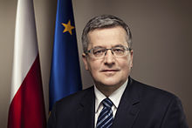
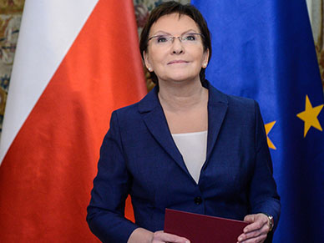
President of Poland Bronisław Komorowski
The Prime Minister of Poland Ewa Kopacz

Slide 6
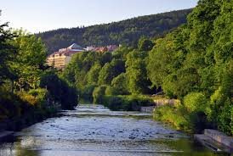
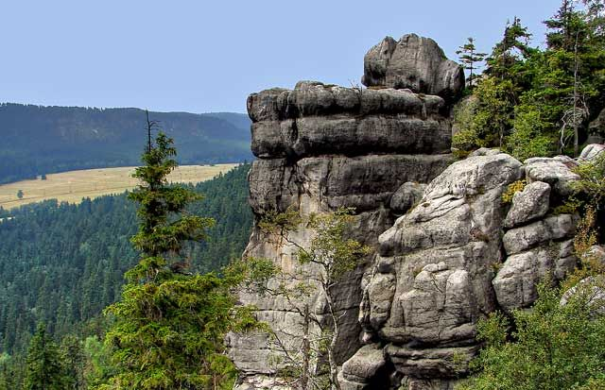
Polish Sights
Poland experienced an increase in the number of tourists after joining the European Union. Tourism in Poland contributes to the country's overall economy and makes up a relatively large proportion of the country's service market
The Vistula River
Stołowe Mountains

Slide 7
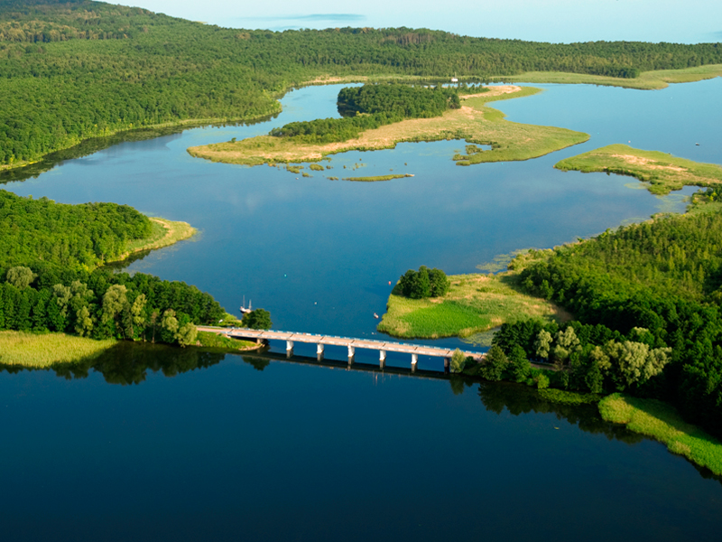
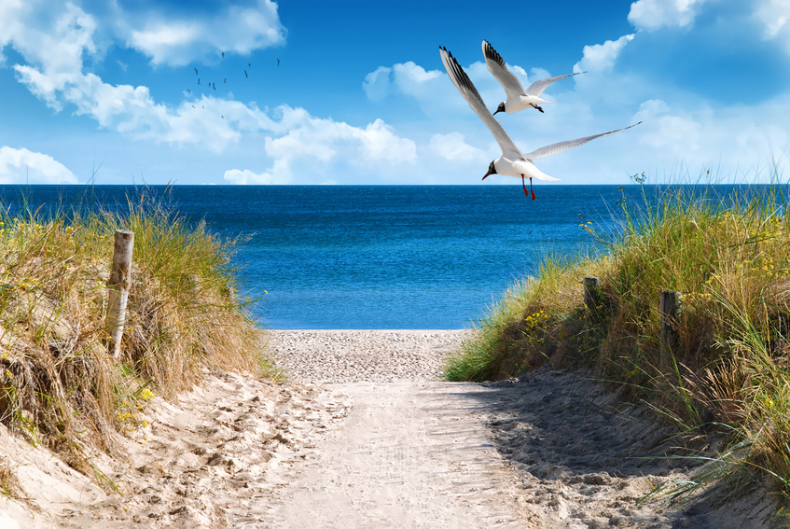
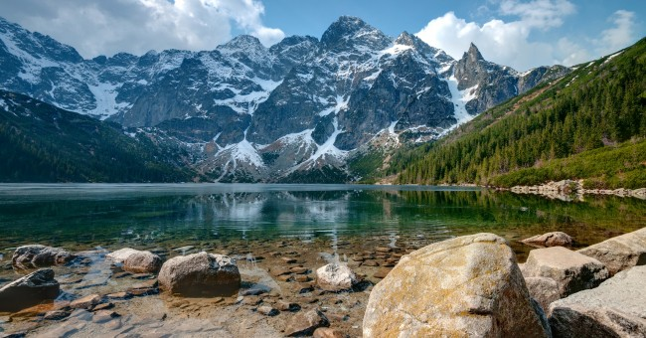
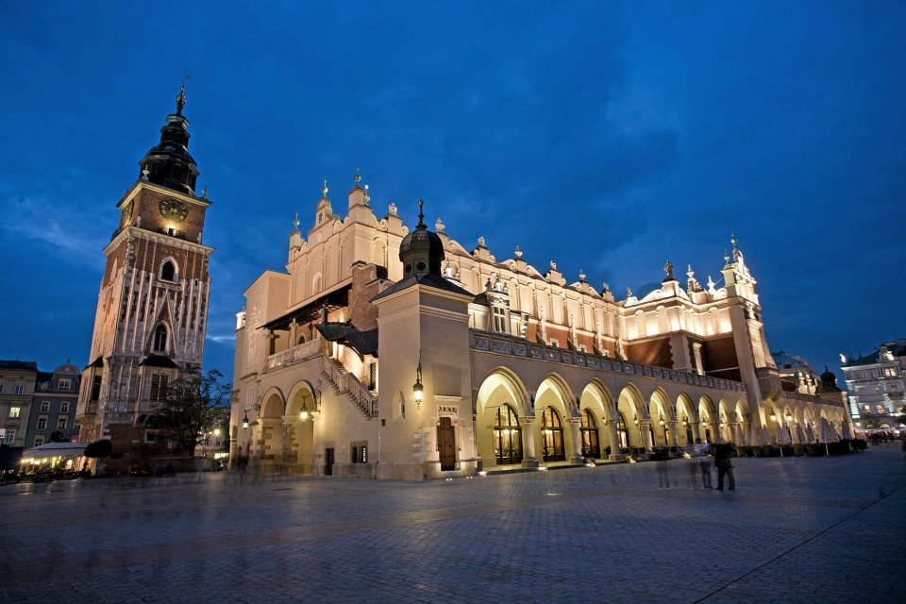
Masuria - the land of a thousand lakes
Baltic Sea
Zakopane
Cracow

Slide 8
Education in Poland
Education in Poland starts at the age of five or six (with the particular age chosen by the parents) for the '0' class and six or seven years in the 1st class of primary school (Polish szkoła podstawowa). It is compulsory that children participate in one year of formal education before entering the 1st class at no later than 7 years of age.
At the end of the 6th class when students are 13, students take a compulsory exam that will determine their acceptance and transition into a specific lower secondary school (Middle School/Junior High). They will attend this school for three years during classes 7, 8, and 9.
Students then take another compulsory exam to determine the upper secondary level school they will attend. There are several alternatives, the most common being the three years in a lyceum or four years in a technikum. Both end with a maturity examination (Matura, quite similar), and may be followed by several forms of upper education, leading to licencjat or inżynier (the Polish Bologna Process first cycle qualification), magister (second cycle qualification) and eventually doctor (third cycle qualification)

Slide 9
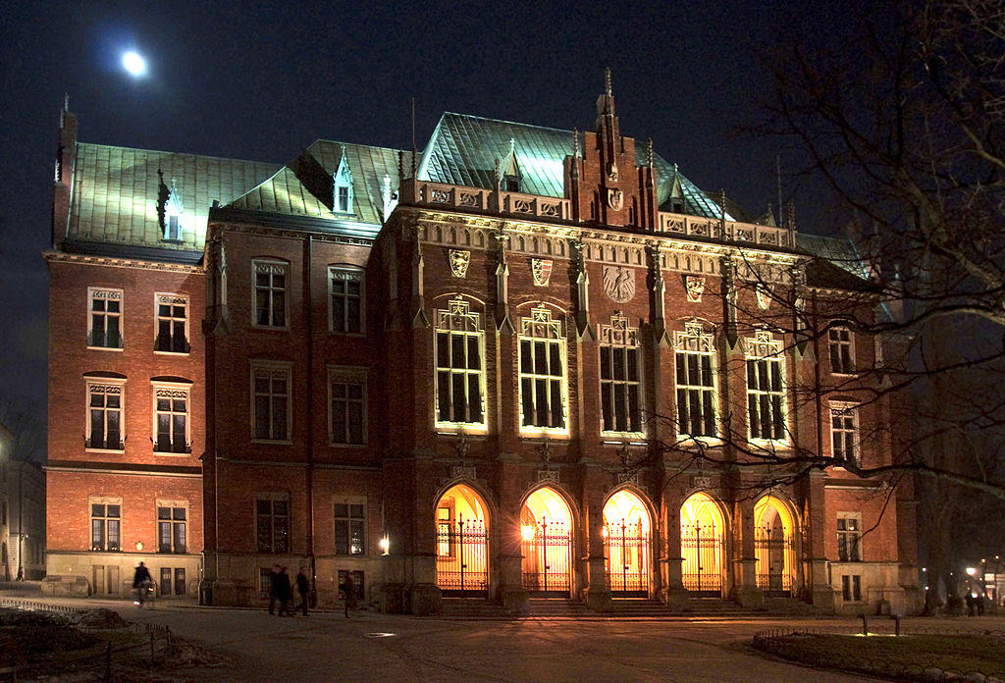
Some of the most popular Universities in Poland
Jagiellonian University in Cracow

Slide 10
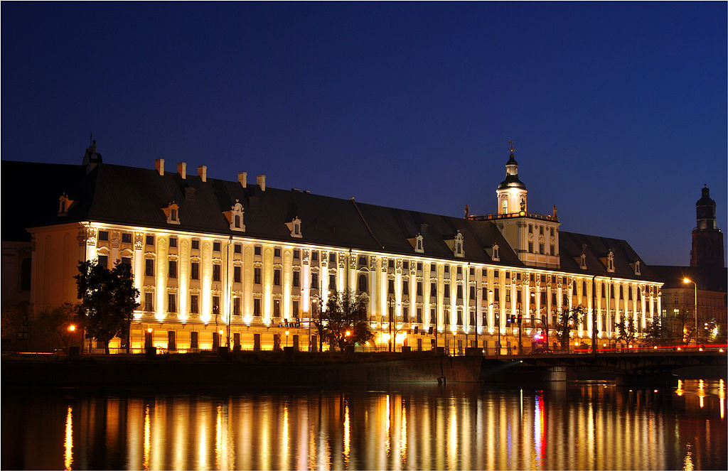
University in Wrocław

Slide 11
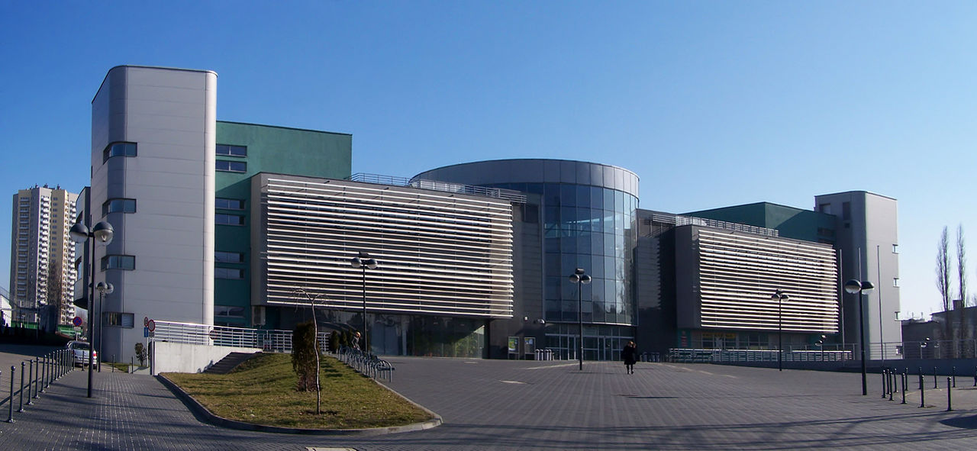
University in Katowice

Slide 12
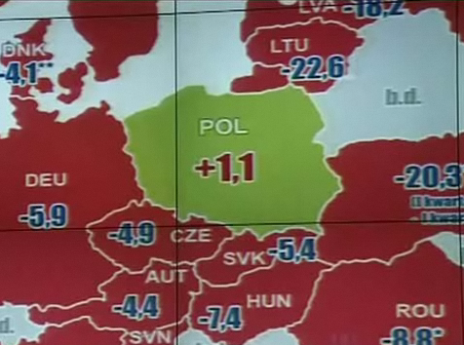
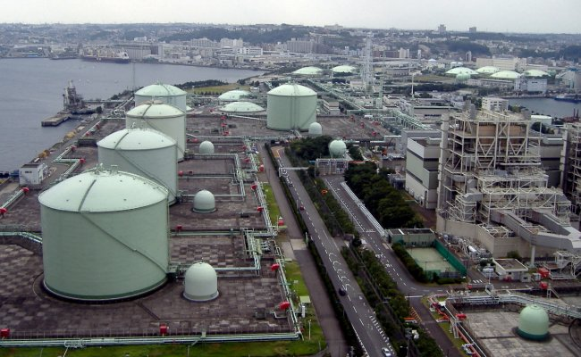
Economy
Poland's high-income economy is considered to be one of the healthiest of the post-Communist countries and is one of the fastest growing within the EU. Having a strong domestic market, low private debt, flexible currency, and not being dependent on a single export sector, Poland is the only European economy to have avoided the late-2000s recession. Since the fall of the communist government, Poland has pursued a policy of liberalising the economy. It is an example of the transition from a centrally planned to a primarily market-based economy. In 2009 Poland had the highest GDP growth in the EU - 1.6%. The country's most successful exports include machinery, furniture, organic foods and meats, motor boats, light planes, hardwood products, casual clothing, shoes and cosmetics.

Slide 13
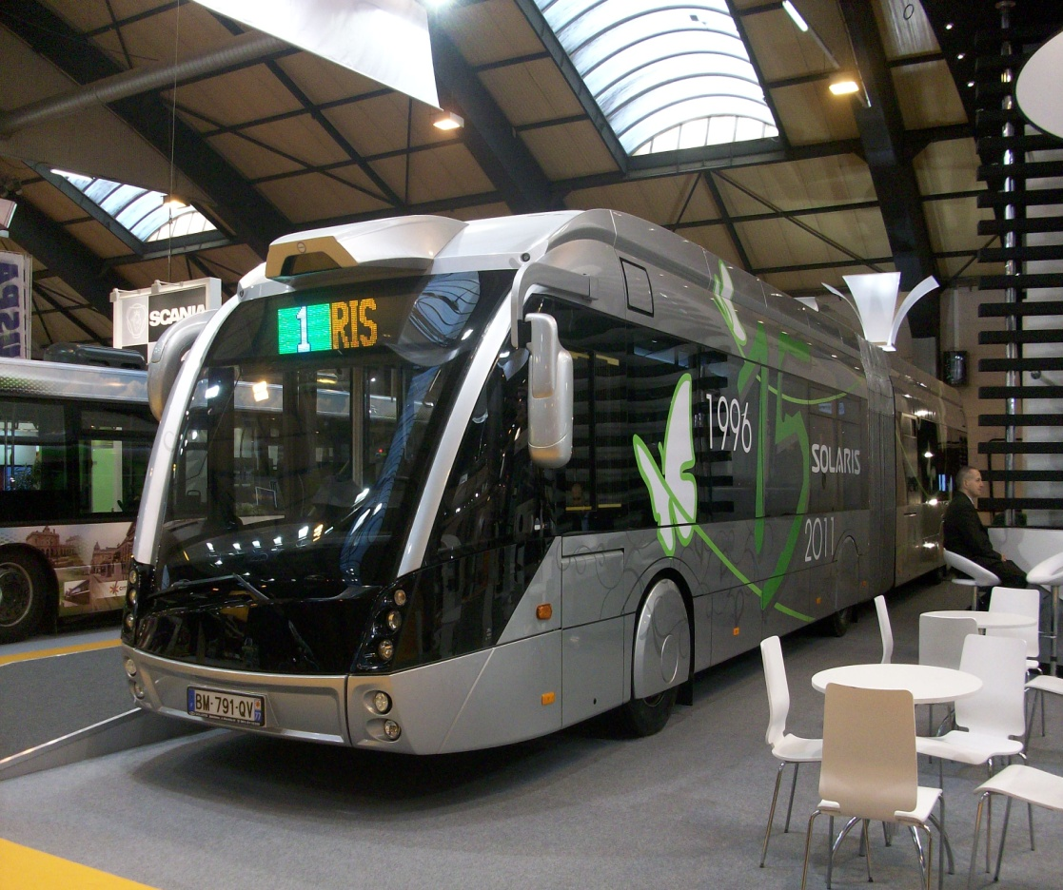
Polish companies
Solaris Bus & Coach
Furniture Factory BODZIO

Slide 14
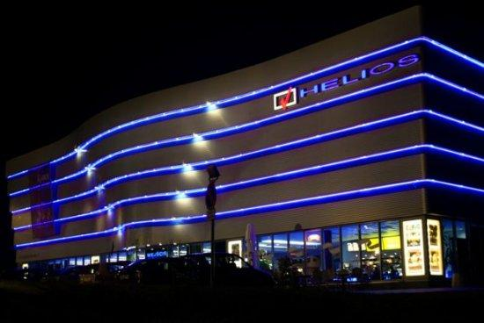
Amica Rtv Agd
Cropp
CLOTHING
Orlen Petrolium
Helios

Slide 15
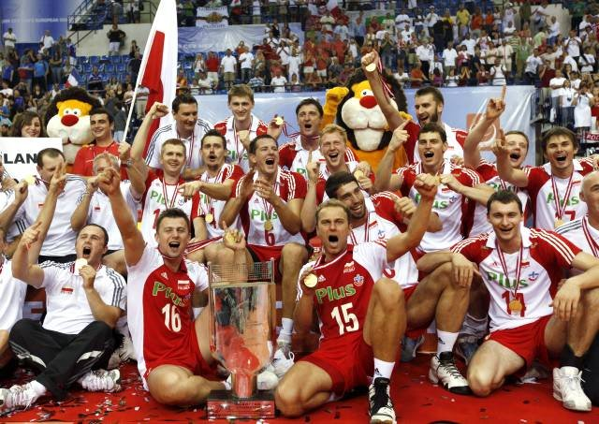
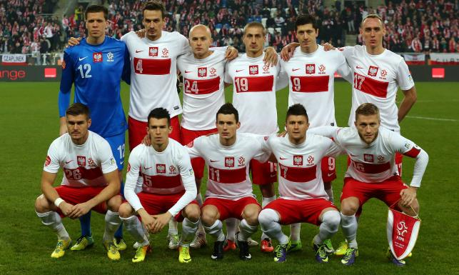
Sports in Poland
Football (soccer) is one of country's most popular sports, with a rich history of international competitions. Track and field, basketball, volleyball, handball, boxing, MMA, motorcycle speedway, ski jumping, cross-country skiing, ice hockey, tennis, fencing, swimming and weightlifting are other popular sports.
Poland, along with Ukraine, hosted the UEFA European Football Championship in 2012.
The Polish men's national volleyball team is ranked as 3rd in the world.
Mariusz Pudzianowski is a highly successful strongman competitor and has won more World's Strongest Man titles than any other competitor in the world, winning the event in 2008 for the fifth time.
The first Polish Formula One driver, Robert Kubica, has brought awareness of Formula One Racing to Poland

Slide 16
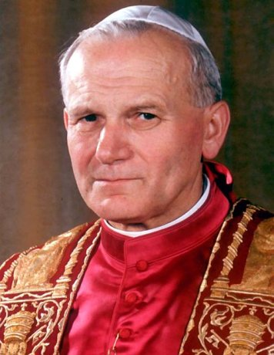
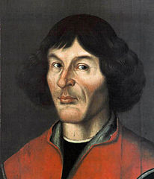
Famous Poles
Pope John Paul II (born Karol Józef Wojtyła 18 May 1920 ‒ 2 April 2005) was pope of the Catholic Church from 16 October 1978 until his death on 2 April 2005.
Nicolaus Copernicus (Mikołaj Kopernik) was a Renaissance mathematician and astronomer who formulated a model of the universe that placed the Sun rather than the Earth at its center.

Slide 17
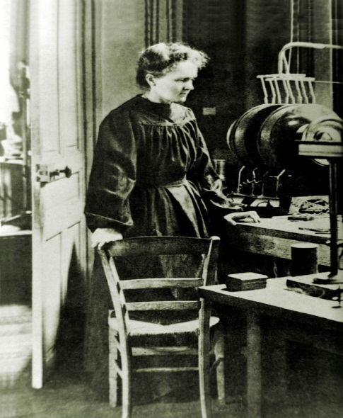
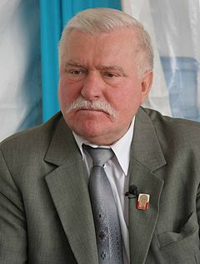
Famous Poles
Lech Wałęsa is a Polish politician, trade-union organizer, philanthropist and human-rights activist. A charismatic leader, he co-founded Solidarity (Solidarność), the Soviet bloc's first independent trade union, won the Nobel Peace Prize in 1983, and served as President of Poland from 1990 to 1995.
Marie Skłodowska-Curie was a Polish physicist and chemist
who conducted pioneering research on radioactivity. She was the first woman to win a Nobel Prize, the first person (and only woman) to win twice.

Slide 18
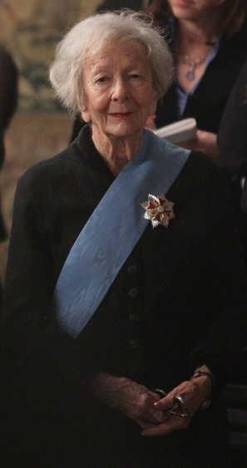
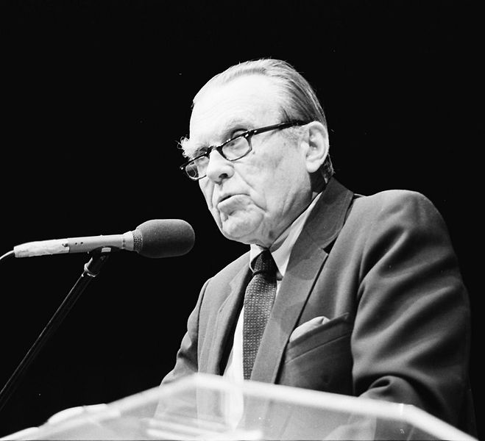
Famous Poles
Czesław Miłosz was a Polish poet, prose writer, translator and diplomat of
Lithuanian origin. He served as Polish cultural attache in Paris and Washington, D.C.He became a U.S. citizen in 1970. In 1978 he was awarded the Neustadt International Prize for Literature, and in 1980 the Nobel Prize in Literature.
Wisława Szymborska was a Polish poet, essayist, translator and recipient of the 1996 Nobel Prize in Literature.

Slide 19
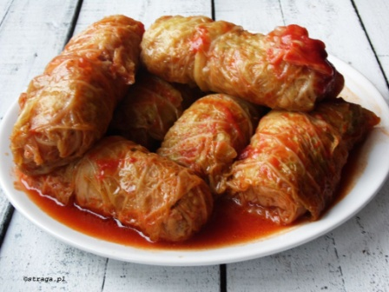
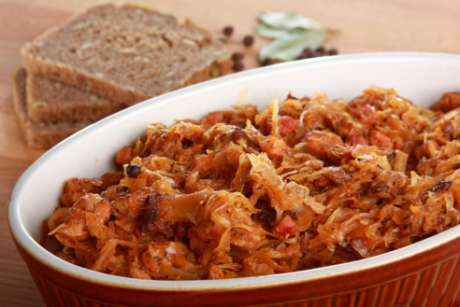
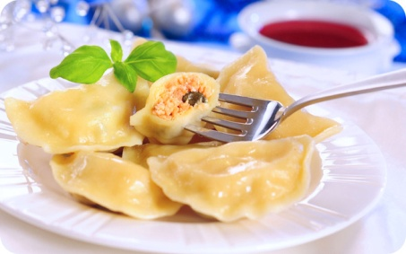
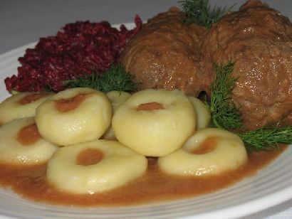
Some of Polish traditional dishes
Bigos (hunter's stew), Polish national dish with various cuts of meat, sausages and cabbage.
Pierogi are dumplings of unleavened dough– first boiled traditionally stuffed with potato filling,
sauerkraut, ground meat, cheese, or fruit.
Gołąbki is a cabbage roll common in Polish cuisine made from lightly soft boiled cabbage leaves wrapped around minced pork or beef, chopped onions and rice or barley, which are baked in a casserole dish and are usually served with a creamy tomato sauce.
Silesian dumplings (kluski śląskie) are potato dumplings with a small depression in the center. They are served with a roulade (typically consisting of a slice of meat rolled around a filling) and red cabbage.

Slide 20
Made by:
Kamil Kramarczyk
Szymon Naglik

