Slide 1
DESCRIPTION OF OUR HOMETOWN “Let`s Break The Ice With School” HADIM COK PROGRAMLI ANADOLU LISESI HADIM,KONYA 2015

Slide 2
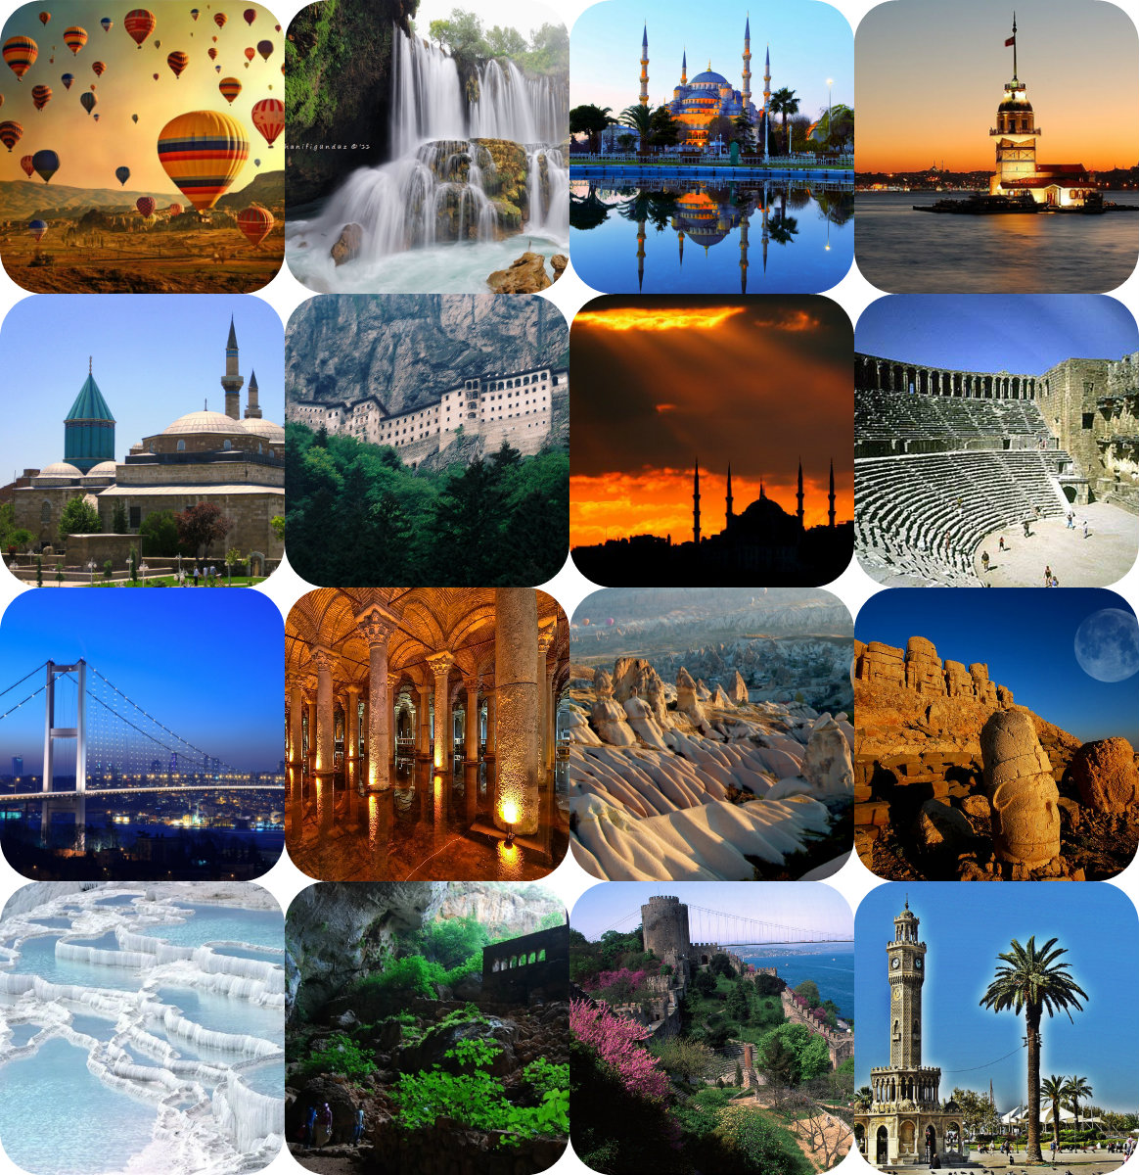

Slide 3
The Republic of Turkey
located in the northern hemisphere
forming the transition point between Asia and Europe
surrounded by sea on three sides
Neighbour to Georgia, Bulgaria, Armenia, Azerbaijan, Iran, Iraq and Syria.

Slide 4
The founder of Turkish Republic is Mustafa Kemal Atatürk.

Slide 5
The Capital City of Turkey is Ankara.

Slide 6
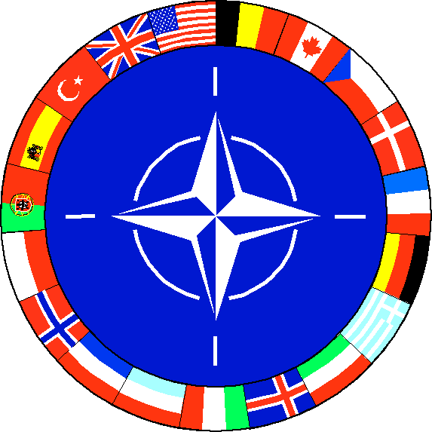
Turkish Repuclis is the member of
the United Nations,
NATO,
the Organization of the Islamic Conference,
the Council of Europe.

Slide 7
The beauties from Turkey Istanbul

Slide 8
Safranbolu (Karabük)

Slide 9
Mount nemrut ( Adıyaman- Kahta)

Slide 10
Xanthos-Letoon (Antalya-Muğla)

Slide 11
Troy ( Çanakkale)

Slide 12
Pamukkale- Hierapolis (Denizli)

Slide 13
Goreme National Park and Cappadocia (Nevşehir)

Slide 14
Capital city of tolerance:Konya

Slide 15
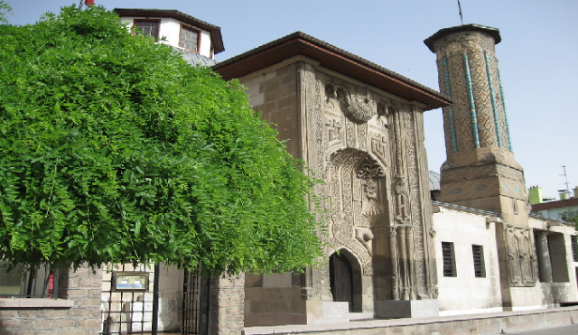
KONYA
One of the world’s oldest settled places and located on the Silk Road, Konya is the largest city in Central Anatolia. In the past it was the capital of the Anatolian Selcuk Sultanate.

Slide 16
The Tomb Of Mevlana :
The famous theologian and Sufi Mystic Mevlana Celalettin Rumi is synonymous with Konya (“Home of the Whirling Dervishes”)
Messages of peace, brotherhood, tolerance, and love are enshrined by the famous verse of acceptance “Come, come, whoever you are!” and more than 8 centuries after his death, visitors still flock here!

Slide 17
Alaeddin Hill and Mosque:
Alaeddin Hill is a site that’s referred to as a protohistoric settlement site by some archeologists and historians.There is a mosque on the same hiil which is the largest and oldest mosque built by the Anatolian Seljukid Sultan Alaeddin Kayqubad I in Konya.

Slide 18
Aya-Elena Church :
The tiny village of Sille, 8km northwest of Konya has a long and interesting history. Helena, mother of Byzantine Emperor Constanine, stopped in Konya during her journey to Jerusalem for a Hajj pilgrimage in 327 AD, and after seeing the engraved temples here belonging to the first ages of Christianity, she too decided to construct a temple. The Aya -Elena Church, contains a rostrum and some fairly well preserved murals, which are unique works of art.

Slide 19
Konya was the capital city of Turks for 211 years.It became the center of knowledge, culture and civilization of Anatolia .

Slide 20
THANKS FOR YOUR ATTENTION!

